Slide 1
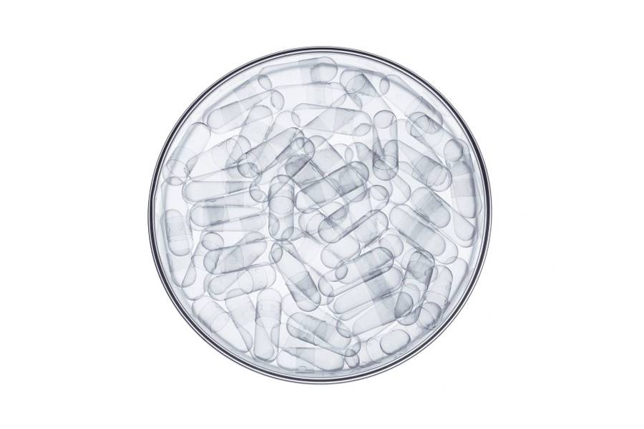
"FDA Drug Approval Data Analysis"
Ankush Brella

Slide 2
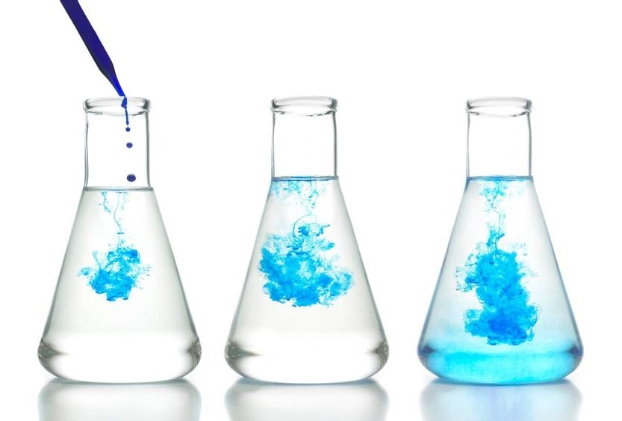
Index
Project Objectives
Yearly Approval Trends of Drugs
Approval Trends by Sponsors
Segmentation Analysis Based on Marketing Status
Total Applications for Each Marketing Status
Analyzing Drug Grouping by Dosage Form
Therapeutic Classes and Approval Trends
Summary

Slide 3
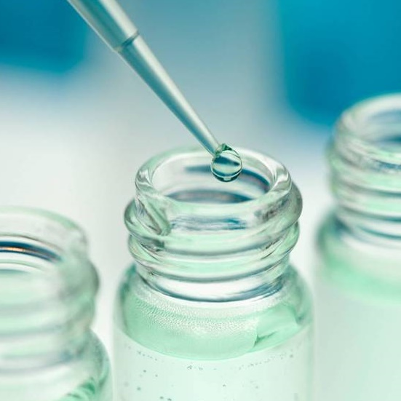
Project Objectives:
The FDA's mission is to protect and promote public health by ensuring the safety and effectiveness of a wide range of products and substances. So, our role is to create informative reports by conducting a thorough analysis of the data provided by them.
Yearly Approval Trends of Drugs
Approval Trends by Sponsors
Segmentation Analysis Based on Marketing Status
Total Applications for Each Marketing Status
Analyzing Drug Grouping by Dosage Form
Therapeutic Classes and Approval Trends

Slide 4
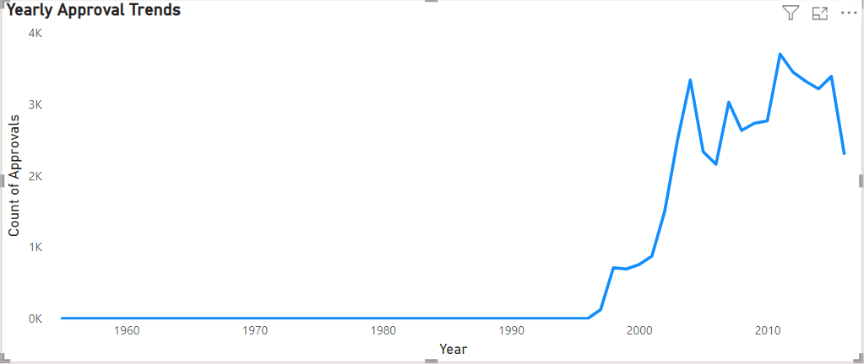
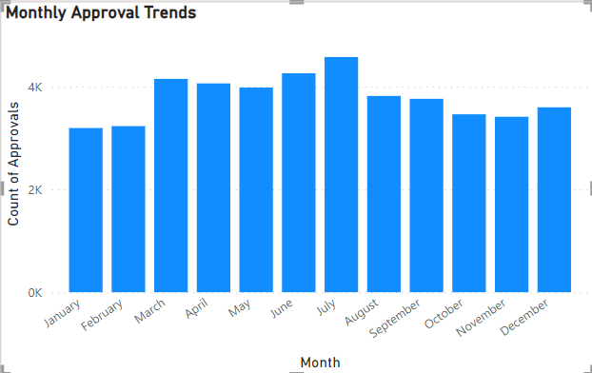
Yearly Approval Trends of Drugs
The most approvals of the drug can be seen in 2011 with a staggering 3698 number.

Slide 5
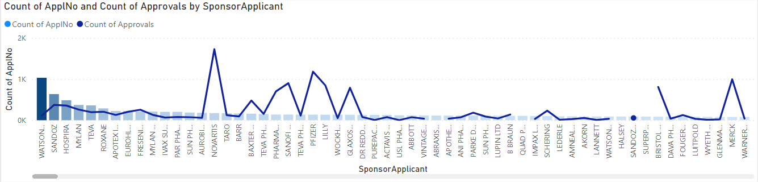
Approval Trends by Sponsors
Most applications were submitted by the sponsor Watson’s Lab, whereas most applications approved were from the NOVARTIS.

Slide 6
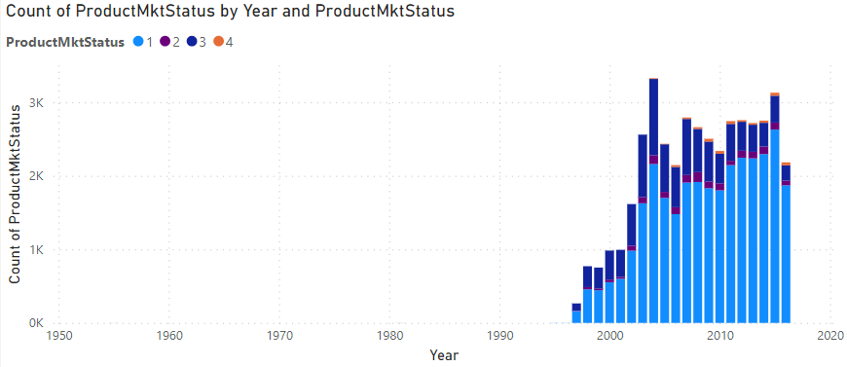
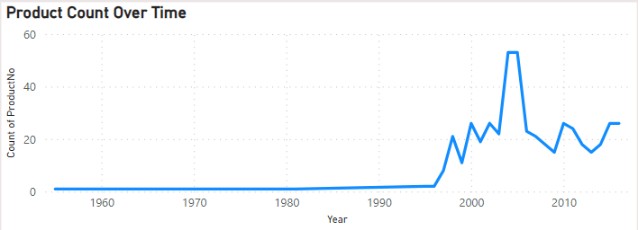
Segmentation Analysis Based on Marketing Status
Most products were manufactured for the market status 1.
Most products were manufactured in the year of 2004 and 2005.

Slide 7
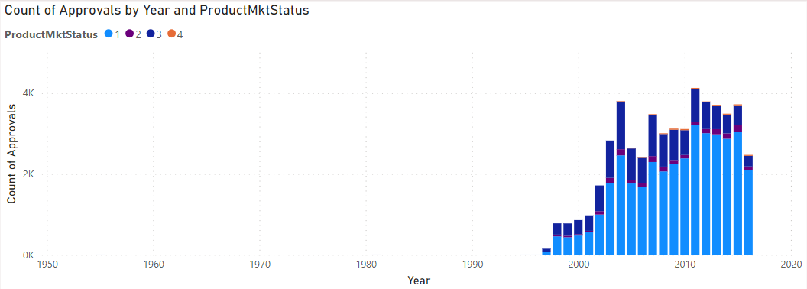
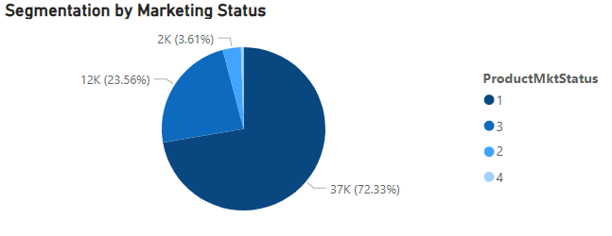
Total Applications for Each Marketing Status
Most applications were submitted for the market status 1.
Most applications are approved for the
market status 1.

Slide 8
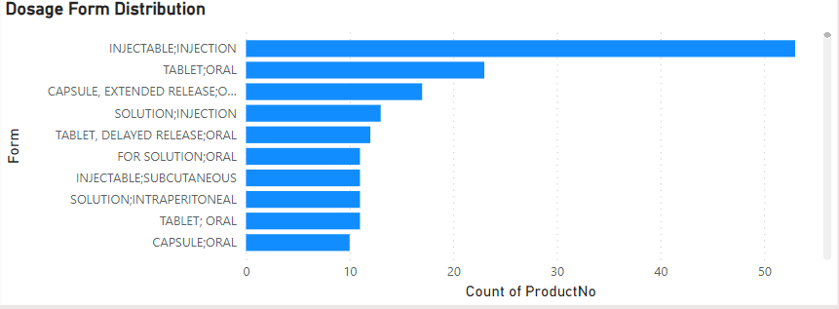
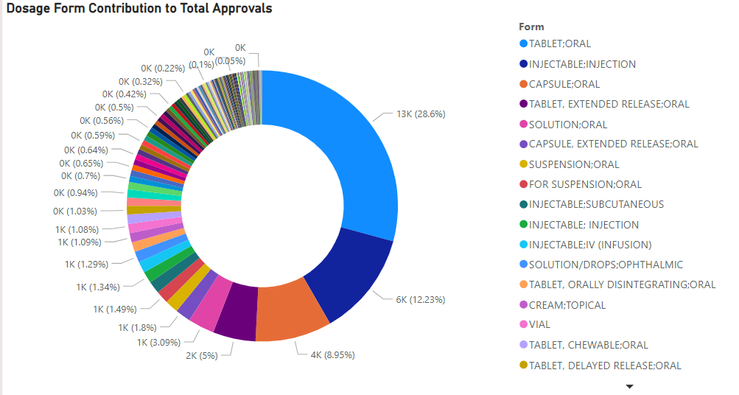
Analyzing Drug Grouping by Dosage Form
Most drug forms produced: Injectable injection.
Most approved drug form: Tablet; Oral

Slide 9
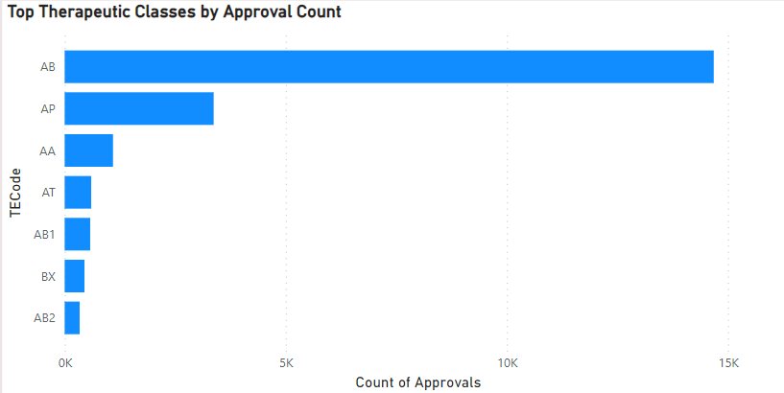
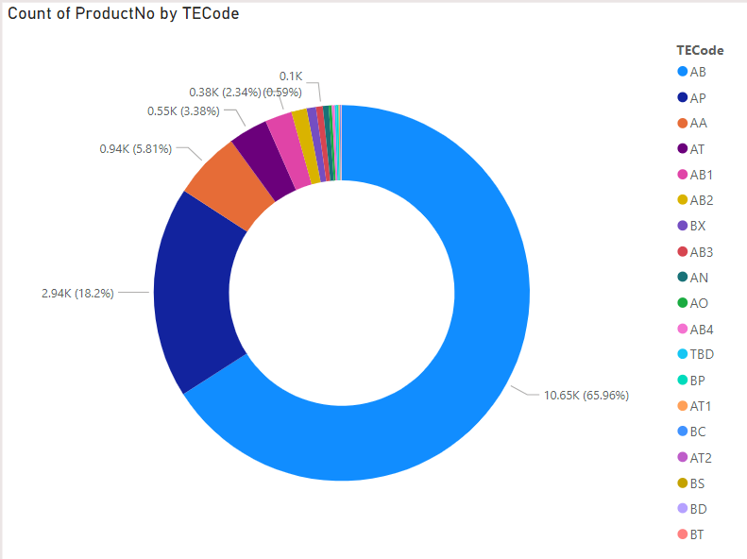
Exploring Therapeutic Classes and Approval Trends
Most Therapeutic class approved: AB
Most Therapeutic class produced: AB

Slide 10

conclusion
The year 2011 witnessed the highest number of drug approvals, with a staggering total of 3,698 approvals.
Watson’s Lab emerged as the sponsor with the highest number of submitted applications, while NOVARTIS had the most applications approved.
Market status 1 was the most common status for product manufacturing and application submission, indicating a preference for marketing new products.
The years 2004 and 2005 saw the highest production of drugs, reflecting significant activity in the pharmaceutical industry during that period.
Injectable injection emerged as the most common drug form produced, while tablets for oral administration were the most commonly approved drug form.
The therapeutic class AB had the highest number of approved drugs and was also the most produced therapeutic class.

